Slide 1



BridGing the Health GAP
FOR women & Girls
Graciela Soto, MD MSc
Clinical Associate Professor
Albert Einstein College of Medicine
Bronx, NY, U.S.A.

Slide 2
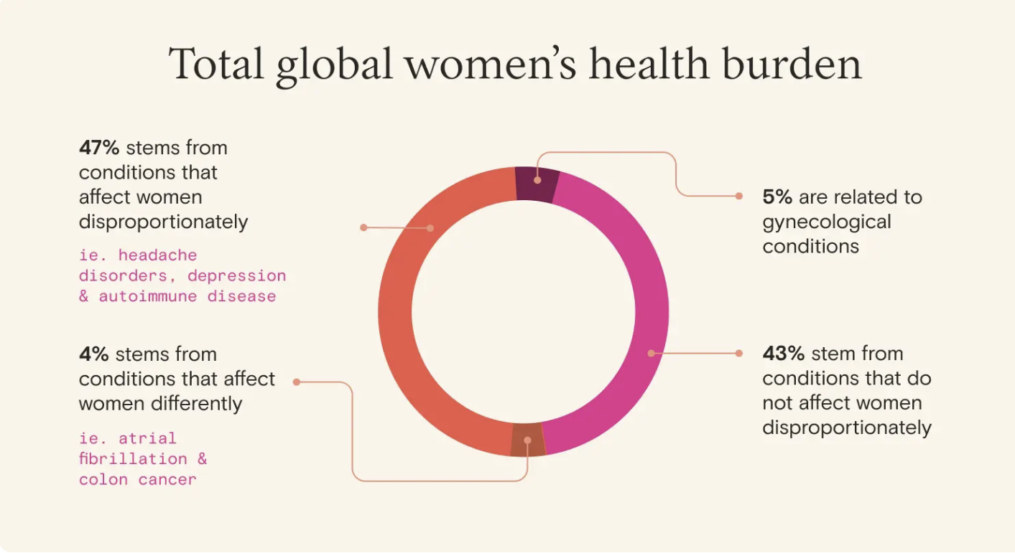
i e. chronic conditions (cardiac disease, diabetes, hypertension)
McKinsey Health Institute, Report, Jan 2024
Notes:
About half of women's health problems are due to conditions that affect women more than men

Slide 3
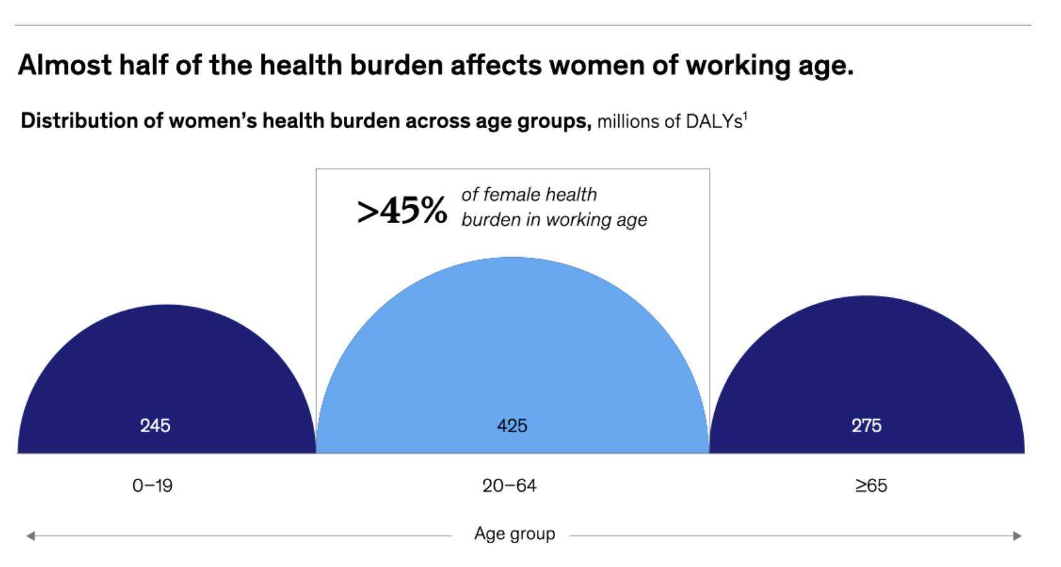
McKinsey Health Institute, Report, Jan 2024
Notes:
McKinsey Health Institute, Report, Jan 2024

Slide 4
The Scope of the problem
Women and Girls face a 15–40% "gender health gap" involving:
distinct symptom presentation
underdiagnosis (e.g., misdiagnosed common conditions)
inappropriate use of diagnostic tools or evidence-based protocols
different response to medical treatments
less healthcare utilization
Women live longer but spend 25% of their lives in poor health compared to men and have distinct health needs across their lifespan.

Slide 5
Gender differences in Morbidity & MORTALITY
CARDIOVASCULAR DISEASE
HYPERTENSION & STROKE
DIABETES
Different symptoms and late diagnosis by up to 10 years
2X higher mortality after heart attacks
Less likely to be referred to a cardiologist, be hospitalized, and to receive guideline-recommended treatments
Hypertension is a stronger risk factor for stroke, particularly post-menopause
“Atypical” stroke symptoms cause delays in diagnosis & treatment
Higher mortality, worse functional outcomes & disability
Delayed diagnosis by 4.5 years
Worse glucose control
3x higher cardiovascular mortality
Higher rates of eye complications and blindness
HIV/AIDS
REPRODUCTIVE HEALTH
MENTAL HEALTH
Women make up 53% of people living with HIV worldwide
Faster progression to AIDS
Sub-Saharan Africa: adolescent girls and young women (15-24) are 3X more likely to acquire HIV than males their age
Limited autonomy and decision-making
Inadequate access to family planning and care
STDs/HIV
Unintended pregnancies, high maternal mortality
3X more likely to experience mental health disorders
Depression, Anxiety/PTSD, Anorexia
3X higher rates of suicide attempts
1.6X more likely to develop dementia

Slide 6
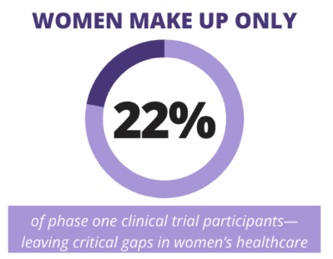
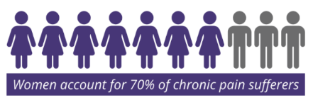
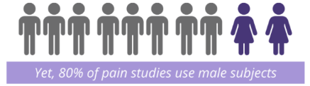
Factors associated with the Gender health gap
Research studies do not acknowledge gender differences
There is not enough essential data about women’s health
Inequalities in healthcare delivery
Notes:
Research studies do not acknowledge gender differences – focus on deadly diseases, some medicines do not work the same
There is not enough essential data about women’s health – takes longer for women to get an accurate diagnosis
Inequalities in healthcare delivery – from physician/patient education to diagnosis to treatment and prevention

Slide 7
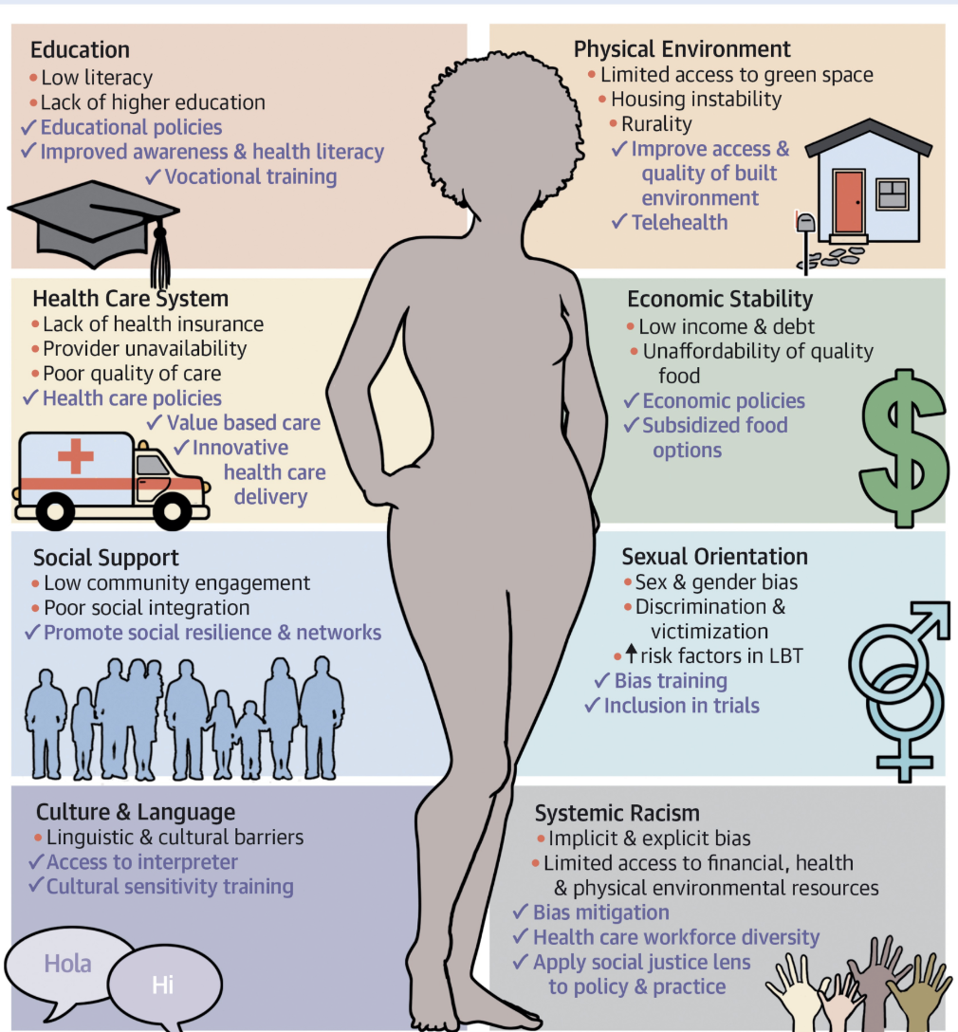
Social & Structural Determinants of Health
SAFETY: gender-based violence (e.g., IPV)
EDUCATION: digital health literacy & access
CULTURE/SOCIAL: family responsibilities

Slide 8
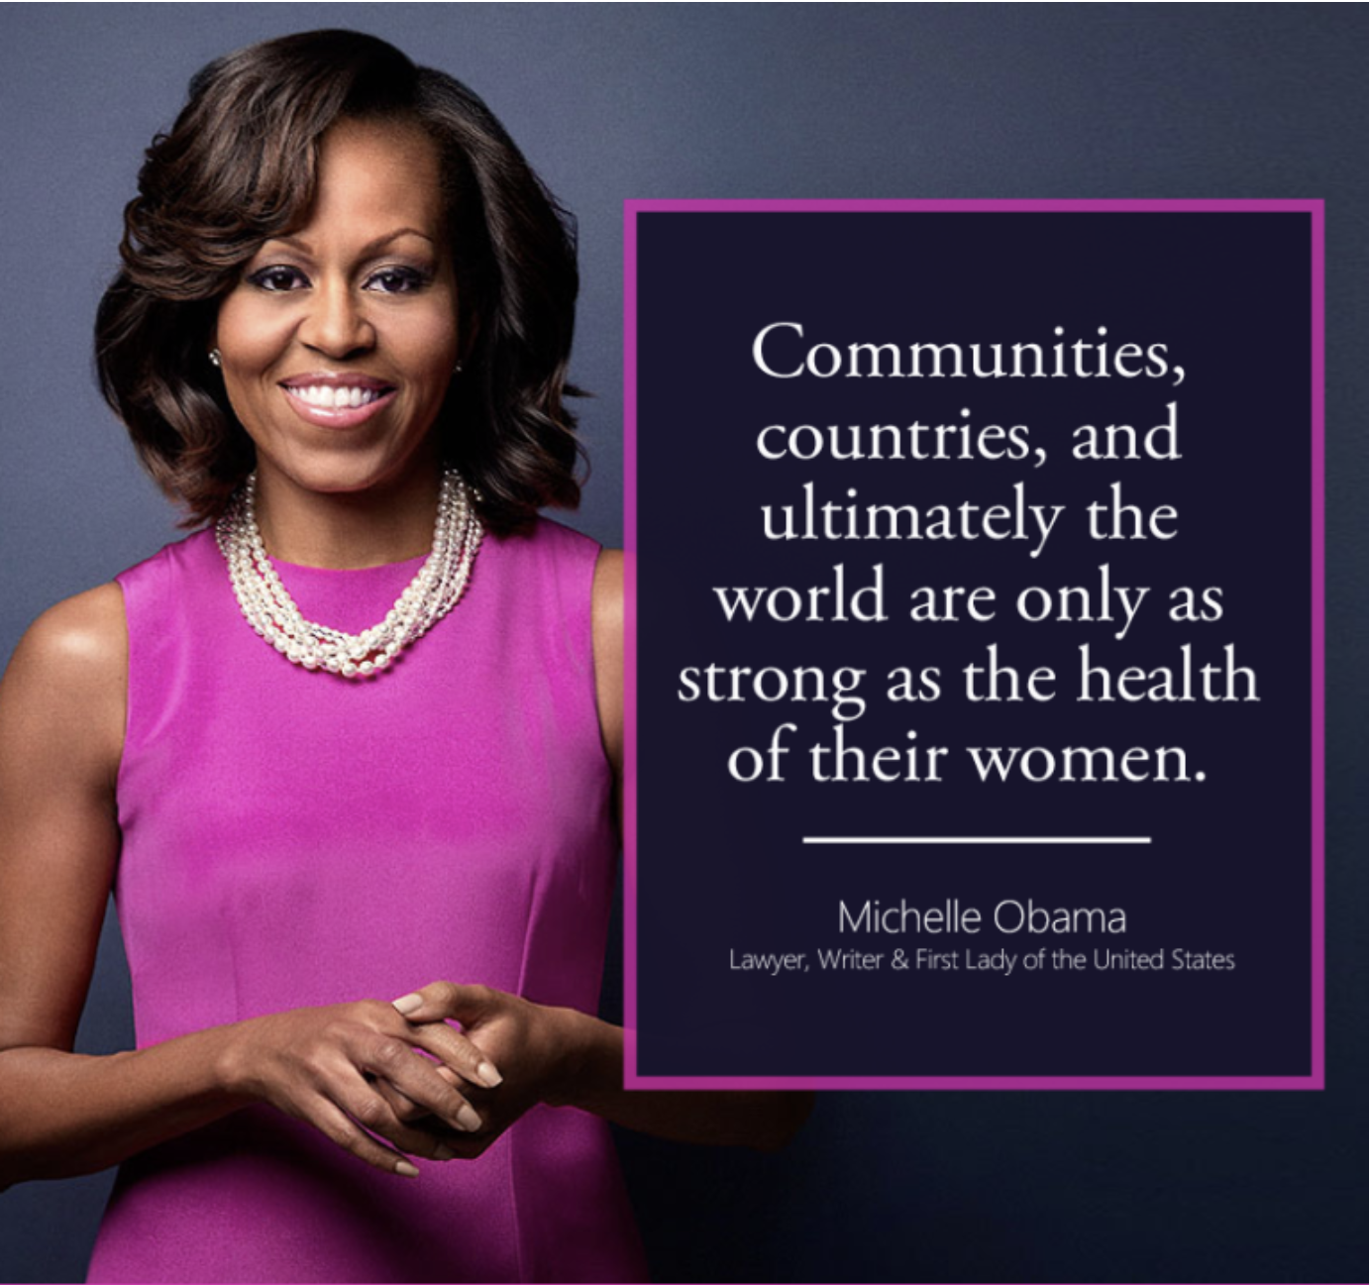

Slide 9
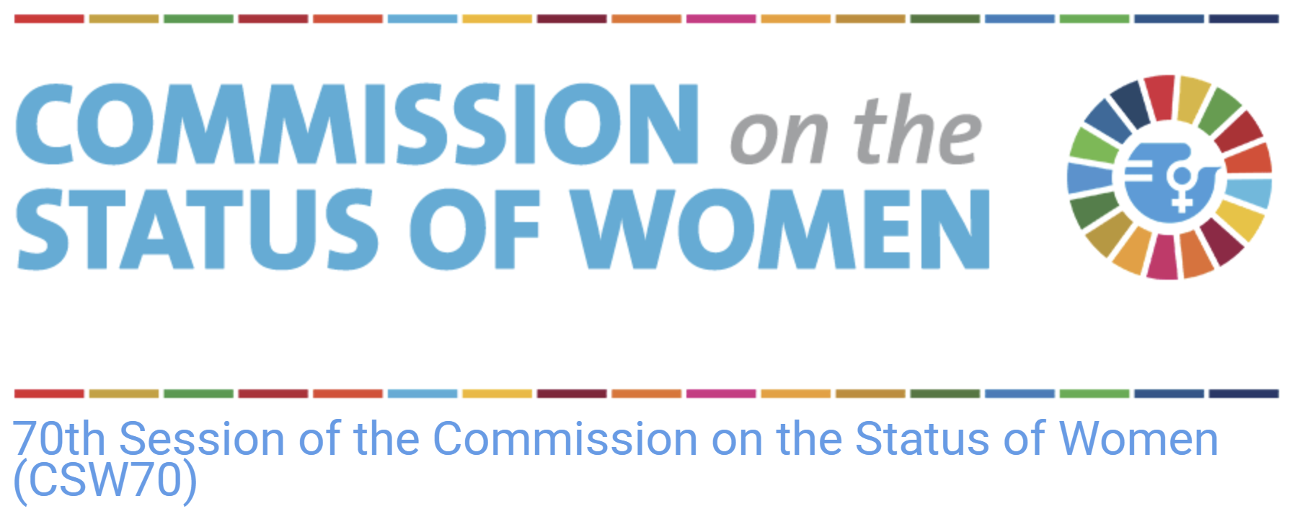

Side event:
“Justice in the Digital Age: Advancing Women's Right to Health in Low-Literacy and Digitally Excluded Contexts”
Date: 19 March 2026
Time: 11:30 am - 12:30 pm
Venue: United Nations Headquarters, New York, Conference Room 8
Missions: Greece, Portugal, and Brazil
Notes:
Digital health systems are increasingly central to the realization of women’s right to health, with significant potential to improve access to information and services and to support women’s autonomy and informed decision-making.
Digital platforms, telemedicine, electronic health records, mobile health applications, and AI-based technologies can help expand access to care, particularly in settings affected by geographic isolation, health workforce shortages, cost barriers, and fragmented health systems. However, these benefits are not experienced equally by all women.
Unequal access to digital technologies, limited connectivity, and low levels of digital and health literacy continue to create substantial barriers to healthcare access, particularly for women in vulnerable and marginalized circumstances.
From a justice perspective, the digital divide constitutes a critical structural determinant of health, directly associated with disparities in access and poorer health outcomes among disadvantaged women and girls
Therefore, with the sponsorship of the Missions of Greece, Portugal, and Brazil, the Health Task force is presenting this side event for the CSW 2026 on (read title) . This side event directly supports the Commission’s focus on Justice by addressing digital exclusion in healthcare as a structural barrier to women’s equality and women’s right to health. As health systems continue to digitalize, women in low-literacy and marginalized contexts face systemic challenges that limit equitable access to care.

Slide 10
Objectives
Highlight how barriers related to literacy, connectivity, data, and system design limit women’s access to digital health
Explore evidence-informed approaches to digital health that improve access, quality, and fairness for women
Elevate women’s experiences and contributions to the design and governance of digital health systems
Identify policy-relevant actions to ensure digital health transformation advances equitable health outcomes
Notes:
The event will highlight rights-based, evidence-informed digital health approaches that promote fairness, accountability, inclusive design, and the meaningful participation of women in health policy and system development.

Slide 11


