Slide 1
U.S. Feminist Foreign Policy: Update and Significance
US Women’s Caucus
Dec. 13, 2023
Sung Sohn, M.Ed.
Co-founder & Executive Director, ESJF
Feminist Foreign Policy Director, USWC

Slide 2
Education for Social
Justice Foundation
The Education for Social Justice Foundation (ESJF) provides education on past injustices relegated to the sidelines of history. With students, educators, scholars, and activists across the world, we’re committed to advancing social justice through education.
ESJF incorporates lessons learned from history to develop dignity-affirming and inquiry-based curricula.
Copyright © 2018–2023 Education for Social Justice Foundation. All rights reserved.

Slide 3
Two Pillars
I. Social Justice Education
II. Advocacy
International Community Outreach
Chiba Korean Elementary Middle School
Days for Girls International
UN NGO In special consultative status with the UN Economic and Social Council (ECOSOC)

Slide 4
Focus Areas include
Sexual and gender-based violence (SGBV)
History of and issues surrounding the Asian diaspora in the U.S.
Resistance and collective activism

Slide 5
Today’s Discussion
Brief review of Feminist Foreign Policy (FFP) in Sweden & other countries
U.S. FP
Significance of adopting FFP

Slide 6
Sweden: FFP
1. 2014: First “explicit” FFP
foreign and security policy, development coordination, & trade and promotion
3 R’s—Rights, Representation, & Resources
2. Since 2014, 16 governments adopted FFP

Slide 7
Sweden: limitations
1. Binary focus on women rather than gender, marginalizing LGBTQIA+ individuals
2. Tendency to adopt a narrow agenda that prioritizes representation and diversity over systemic change
3. Saviorism* themes
*It assumes women from foreign countries are in need of Western masculine intervention & protection

Slide 8
Other countries
Similarities
o All focus on changing the existing paradigms to include or increase women and gender in their FFP & practice
o Themes of security & view FFP as integral to advancing gender equality, defending human rights, and promoting peace
Differences
Interpretations & limitations

Slide 9
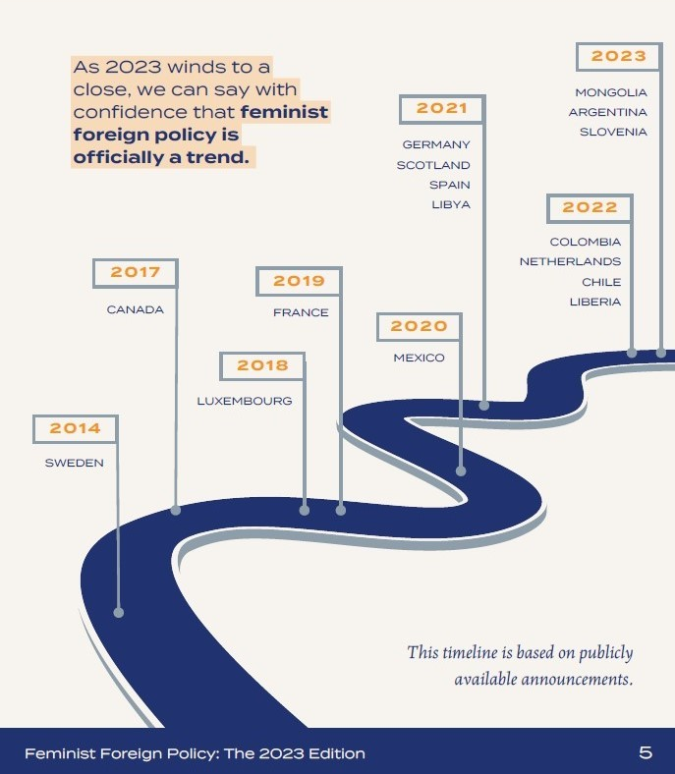
FFP: A Timeline
Credit: Defining Feminist Foreign Policy (2023)

Slide 10
U.S. FFP
1. The U.S. has yet to adopt a feminist foreign policy
2. Military force is one of the primary global tools used in U.S. foreign policy to maintain “security”
3. Though the term “foreign” is used, U.S. foreign policy closely correlates to its domestic policy

Slide 11
U.S. FFP
Civil society’s advocacy
Leading U.S. FFP organizations
Timelines on critical efforts
Definitions

Slide 12
U.S. FFP Orgs
Feminist Foreign Policy Collaborative
The Coalition for a Feminist Foreign Policy in the United States
The International Center for Research on Women (ICRW)

Slide 13
U.S. FFP Timelines
since 2019, 1 of 2
2019: Initial draft of a U.S. feminist foreign policy
2020: Toward a feminist foreign policy in the U.S.
2021:
2021 Defining Feminist Foreign Policy
Biden administration created a new White House Gender Policy Council & National Strategy on Gender Equity and Equality
2022:
January—Coalition submitted the 2021 report card of the administration’s efforts

Slide 14
U.S. FFP Timelines
since 2019, 2 of 2
2023
White House:
January—Coalition submitted 2022 midterm evaluation (report card)
March—the Biden administration approved more than $3 billion federal budget
May—National Action Plan to End Gender-Based Violence
Coalition:
September—Coalition launched the 2023 edition of the seminal Defining Feminist Foreign Policy paper (Sept. 15)
November—the Coalition released the second term evaluation entitled Feminist Foreign Policy in the United States: An Agenda for Action (Nov. 5)
ICRW: The Feminist Foreign Policy Index: A Quantitative Evaluation of Feminist Commitments.
UN General Assembly week—foreign ministers representing the United Nations’ Feminist Foreign Policy Plus group announced the first global declaration on feminist foreign policy (Sept. 20)

Slide 15
U.S. FFP Definitions
The Coalition for a Feminist Foreign Policy in the US
“The policy of a state that defines its interactions with other states, as well as movements and other non-state actors, in a manner that prioritizes peace, gender equality, and environmental integrity; enshrines, promotes, and protects the human rights of all; seeks to disrupt colonial, racist, patriarchal and male-dominated power structures; and allocates significant resources, including research, to achieve that vision. Feminist foreign policy is coherent in its approach across all of its levers of influence, anchored by the exercise of those values at home and co-created with feminist activists, groups and movements, at home and abroad.” (Thompson, Patel, Kripke, O’Donnell, 2020)

Slide 16
U.S. FFP Definitions
USWC
“[It’s] a feminist approach to foreign policy that incorporates principles of equality, non-discrimination, and justice into a government’s foreign relationships. It emphasizes human rights as the central focus of international affairs and assigns states the responsibility to safeguard the human rights of all. Feminist foreign policies promotes non-violence and demilitarization. States with feminist foreign policies commit to transparency and accountability in their programs and practices.”

Slide 17
FFP Findings
World
From 1990–2014, only 10% of peace agreements were signed by women
In 2019, representation of female ministers globally reached a record high, with 20.7% of all ministry positions being held by women. Only 10 countries have 50% or more positions in their cabinet held by female ministers.
An increase of 1 unit in a country’s Women’s Political Empowerment index is linked to an 11.5% decrease in the respective country’s carbon emissions (ICRW, 2023)
For more info—https://www.e4sjf.org/feminist-foreign-policy.html

Slide 18
FFP Findings
U.S. military reliance
Highest military spending in 2022, constituting nearly 40% of total military spending worldwide
U.S. arms exports increased by 14% between 2012–2016 & 2017–2021
U.S. increased military spending contradicts the values contained in FFP definitions developed by 2 U.S. orgs
Women’s reproductive rights under threat
Widespread of anti-trans legislation

Slide 19
Significance and urgency of the U.S. adopting FFP
To interrupt the current suppressive trends toward women’s rights and provide a societal structure for women and girls to exercise their full humanity and rights at home and abroad
As a permanent member of the UN Security Council, the U.S. must uphold the UN Resolution on Women, Peace and Security (WPS)
2000, UN SCR 1325 on WPS
2008, UN SCR 1820 on WPS identifies the use of sexual violence as a tactic of war

Slide 20
Problems of the U.S. not adopting FFP: Overseas 1
Extraterritoriality jurisdiction applies under Status of Forces Agreements (SOFAs) at overseas military installations—often allow the U.S. to retain exclusive jurisdiction over its service members in many Asian countries. This means U.S. military personnel overseas face lighter punishment for an array of human rights violations, including sexual violence committed in host countries.
Additional problems—systematic environmental pollution, including disposal of toxic waste into soil and water in the host countries
ROK, Japan, Afghanistan, & Gaza

Slide 21
Problems of the U.S. not adopting FFP: Overseas 2
ROK
ROK hosts the U.S. military’s largest overseas installation at Camp Humphreys
1992: Kenneth Markle, U.S. serviceman, sexually assaulted and murdered 26-year-old Yun Geum-I, who was found bludgeoned to death with a bottle stuffed into her vagina and an umbrella into her anus
2002: a U.S. armored tank driven by 2 U.S. military personnel ran over 13-year-olds Hyo-Soon and Mi-Sun who died on the spot. A U.S. court-martial found the accused soldiers not guilty of negligent homicide in November 2002.

Slide 22
Problems of the U.S. not adopting FFP: Overseas 3
Okinawa, Japan
Hundreds of rape cases had been committed by U.S. military personnel against Okinawan women and children, who live with Japan’s highest [children’s] poverty rate & the highest number of single-mother households (1945–2011)
1995: custody transfers of 3 U.S. servicemen who kidnapped and repeatedly raped a 12-year-old Okinawan schoolgirl were delayed. The 3 men, who served terms in Japanese prisons, were released in 2003
2016: the dumped body of a 20-year-old woman was found after a 32-year-old former Marine civilian base worker sexually assaulted, raped, and killed her

Slide 23
Problems of the U.S. not adopting FFP: Overseas 4
Asia: 2015 “Comfort Women” Agreement
On Dec. 28, 2015, foreign affairs ministers from the ROK and Japan reached a “comfort women” agreement without the surviving victims’ consent. This agreement was indicated as a “final and irreversible” resolution.
From the 1930s to the end of WWII, the Japanese Imperial Armed Forces established and operated numerous “comfort stations” for Japanese soldiers in the territories they occupied. Numerous women and girls from throughout Asia were forced into this military sexual slavery.
The U.S. applauded the agreement

Slide 24
From 2014 to 2023
April 24, 2014: U.S. Pres. Obama let Japan to reinterpret Japan’s Constitution to allow for collective self-defense
Dec. 28, 2014: Trilateral Information-Sharing Arrangement signed between the U.S., South Korea, and Japan
Dec. 28, 2015: “Comfort Women” agreement
Nov. 23, 2016: South Korea and Japan signed the General Security of Military Information Agreement, GSOMIA
May 2017: ROK deployed the U.S. anti-ballistic missile defense system, Terminal High Altitude Defense (THAAD)
Nov. 22, 2019: GSOMIA suspended over trade disputes
March 2023: GSOMIA restored
Aug. 18, 2023: Trilateral Leaders’ Summit at Camp David
Nov. 21, 2023: North Korea launched its first spy satellite

Slide 25
United Nations
CEDAW: “[The agreement] did not fully adopt a victim-centered approach”—2016
UN Committee Against Torture (CAT): “[The agreement] fails to provide redress and reparation, including compensation and the means for as full rehabilitation as possible as well as the right to truth and assurances of non-repetition. … recommends that South Korea and Japan revise the agreement to provide the surviving victims with redress and reparations.”—2017
Rashida Manjoo, UN Human Rights Council: “Adequate reparations for women cannot simply be about returning them to where they were before the individual instance of violence, but instead should strive to have a transformative potential.”—2010

Slide 26
United States
Dec. 30, 2015: U.S. Secretary of State John Kerry (served 2013–2017), congratulated and thanked S. Korean MOFA Minister for the “successful” resolution of the “comfort women” issue. Kerry also expressed his respect for S. Korean President Park Geun-hye for her courage and vision.
July 20, 2021: US State Dept Spokesperson Ned Price—“As we stated at the time in 2015, we welcome efforts such as the 2015 agreement between the two countries as an example of their commitment to forging a more productive and constructive bilateral relationship. And so even while addressing sensitive historical questions, cooperation on our common regional and international priorities must proceed.”

Slide 27
Problems of the U.S. not adopting FFP: Overseas 5
Afghanistan
Withdrawal of the U.S. from Afghanistan in August of 2021 left the rights and lives of Afghan women and girls at major risk of violence and becoming a casualty of conflict
WFP cut off 10 million people per month from food assistance in Afghanistan (September, 2023)— Only a fifth of Afghanistan’s hungry population will be served
With this drastic funding cut coupled with devastating earthquakes in September, poverty levels this winter will reach unprecedented levels

Slide 28
Problems of the U.S. not adopting FFP: Overseas 6
War on Gaza & beyond:
“The United States stands with the state of Israel.” (Oct. 7, U.S. Pres Joe Biden)
“A cease-fire would allow Hamas to repeat its attack on Israel.” (Nov. 4, U.S. Sec of State Antony Blinken)
Dropping a nuclear bomb on the Gaza Strip is “one of the possibilities” (Nov. 5, Israeli Heritage Minister Eliyahu )
“Israel is determined to kill Hamas’ leaders ‘in every location’ in the world, including Qatar, Turkey, and Lebanon, even if it takes many years,” (Dec. 3, Shin Bet chief Ronen Bar)
Israel killing 2 Palestinian civilians for every Hamas militant is “tremendously positive.” (Dec. 5, senior Israeli military officials)
“You put politics above the return of the kidnapped.” (Dec. 5, freed Israeli hostage)

Slide 29
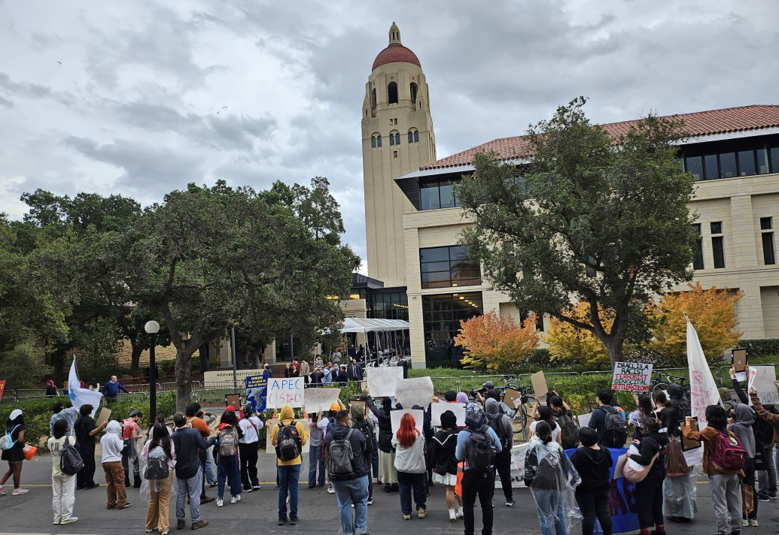
Gaza and SF Bay Area Peace Actions during APEC 2023
Nov. 17

Slide 30
Problems of the U.S. not adopting FFP: Home
U.S. foreign policy has direct correlations to domestic policy
Three women are murdered every day in the US by an intimate partner
U.S. women and girls’ reproductive rights is one of the main areas impacted by regressive policies attacking and threatening women’s rights
CNN map of the current abortion status in the U.S.: https://www.cnn.com/2022/08/31/us/abortion-access-restrictions-bans-us/index.html

Slide 31
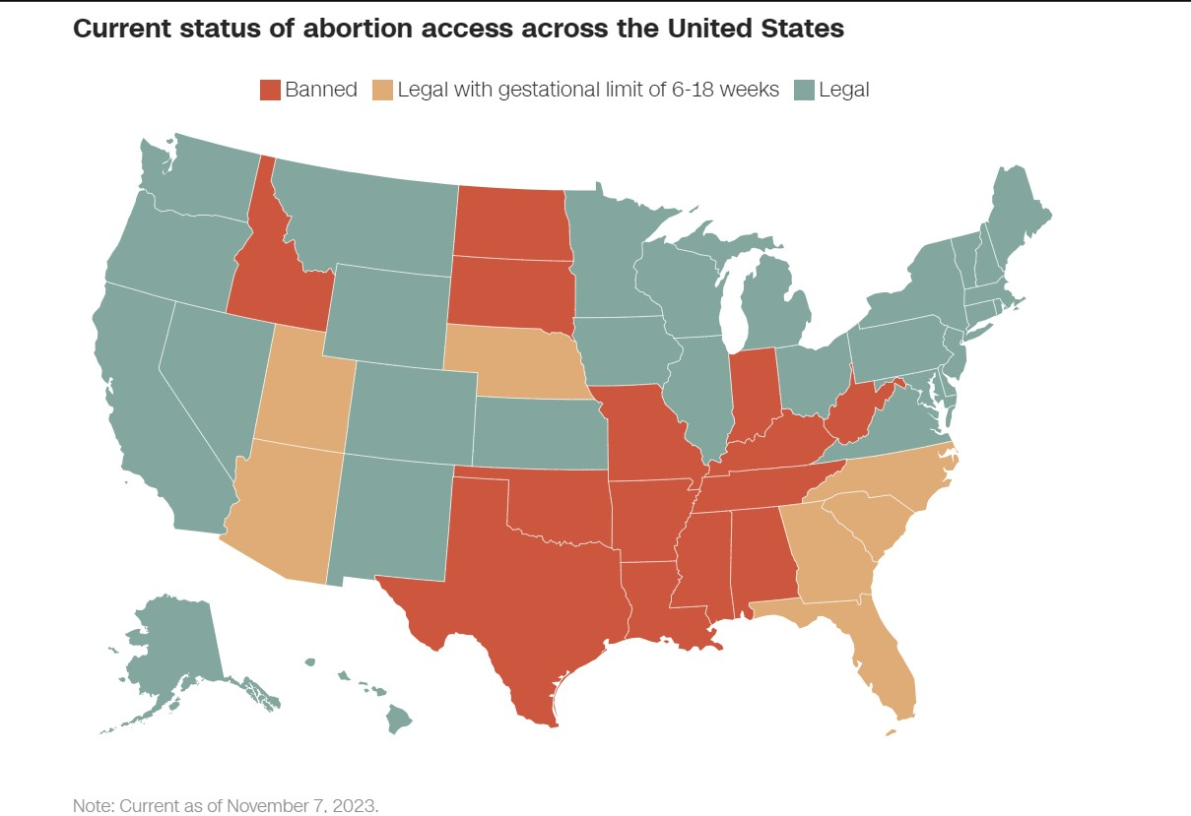
CNN
https://www.cnn.com/2022/08/31/us/abortion-access-restrictions-bans-us/index.html

Slide 32
Solutions: structural change
Recommendations by FFP Index—
https://www.icrw.org/publications/feminist-foreign-policy-index-a-qualitative-evaluation-of-feminist-commitments/
For more info—https://www.e4sjf.org/feminist-foreign-policy.html

Slide 33
Solutions
Education
Collaboration
Significance of peace and countering SGBV
Collaborate w/ civil society—reproductive justice & IANGEL’s TIP
“Comfort Women” History and Issues: Teacher & Student Resource guides, 2018

Slide 34
“Keep fighting for me!”
Kim, Bok-dong (b. Korea, 1926–2019)
Nov. 7, 2018
Image credit: ESJF

Slide 35
Thank you!
ESJF@E4SJF.ORG
Copyright © 2018–2022 Education for Social Justice Foundation. All rights reserved.

Slide 36
Join ESJF
Follow us on Instagram
@e4sjf
Copyright © 2018–2023 Education for Social Justice Foundation. All rights reserved.

