Slide 1
UN Pathways to Human Rights for Women and Girls
The Rev. Susan H. Lee, Ph.D.
President
US Women's Caucus at the UN
Massachusetts Human Rights Coalition
May 12, 2023

Slide 2
Agenda
Challenges to women's human rights in the US
US Women's Caucus at the UN
UN Commission on the Status of Women
UN World Conferences on Women
CEDAW, the international women's rights treaty
1995 UN World Conference on Women Beijing
Cities for CEDAW

Slide 3
Challenges to US Women's Human Rights
Gender pay gap: female full-time workers make about 83% of the pay of male full-time workers; the gap is bigger for those with advanced degrees (US Department of Labor).
Gender gap in care work: Women carry out most unpaid child and elder care and do not receive Social Security credit, reducing their retirement income (Institute for Women's Policy Research).
Maternal mortality rates in the US are much higher than our peer nations. Over 1200 women in the US died due to maternal causes in 2021, up 40% from 2020, and 80% of those deaths were preventable (Centers for Disease Control and Prevention, Women's Congressional Policy Institute).
Violence against women: 3 women are killed daily in the US by an intimate partner, and the easy availability of guns exacerbates the power imbalance. 70 women per month are shot to death by an intimate partner (Sanctuary for Families, Everytown for Gun Safety).

Slide 4
US Women's Caucus at the UN
Our Mission: US feminists collaborating to advance human rights and gender equity for women and girls worldwide
Who we are: US individuals and non-governmental organizations (NGOs) participating in the UN Commission on the Status of Women (CSW) session every March
What we do:
  exchange information and resources and engage in joint advocacy at the CSW
  research CSW annual themes and develop position papers
  promote topics and language for CSW documents with UN states
  for 2023 UN CSW, we developed briefs on gender and technology
See our website for more information uswomenscaucus.org

Slide 5
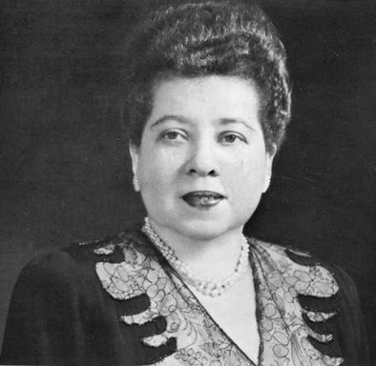
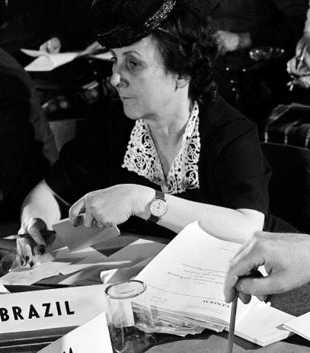
UN Commission on the Status of Women
UN CSW was established at the founding of the UN in 1945 in San Francisco.
Two Latin American diplomats were instrumental in its beginnings.
Minerva Bernardino
Dominican Republic
Bertha Lutz
Brazil

Slide 6
Aims of the female diplomats for the UN 1945 conference:
- a stand-alone commission for women
- language affirming the equality of men and women
UN Charter language, first paragraph:
"We the Peoples of the United Nations
determined to save succeeding generations from the scourge of war ...
and to reaffirm faith in fundamental human rights
in the dignity and worth of the human person
in the equal rights of men and women
and of nations large and small ...
UN Women article on the origins of the UN Commission on the Status of Women:
https://www.unwomen.org/sites/default/files/Headquarters/Attachments/Sections/Library/Publications/2019/A-short-history-of-the-CSW-en.pdf

Slide 7
UN World Conferences on Women
First UN World Conference on Women 1975, Mexico City
  133 government delegations, 113 led by women
  6000 NGO representatives
  produced World Plan of Action
  called for a binding international treaty on women during the UN International Decade on Women 1975-1985
The women's treaty was completed by 1979 and adopted by the UN General Assembly
The Convention on the Elimination of All Forms of Discrimination Against Women CEDAW (see-daw)

Slide 8
CEDAW
30 articles set out women's human rights
  political and citizenship rights
  educational rights
  employment rights
  credit and financial rights
  health rights
  marriage and family rights
Creates a monitoring CEDAW Committee, in Geneva
  23 gender experts elected by the parties
  countries must submit periodic reports for review
  CEDAW Committee issues recommendations

Slide 9
Second UN World Conference on Women
Copenhagen, 1980
  145 country delegations
  8000 NGO participants
  Outcome document: Programme of Action
Official signing of CEDAW by 64 countries
  President Jimmy Carter signed for the US
  US Senate failed to ratify with required 67 votes
By 2023, 189 member states have acceded to CEDAW
  7 countries have not joined the women's treaty
  United States, Sudan, Iran, Somalia, Tonga, Palau, the Holy See

Slide 10
Beijing
Third UN World Conference on Women 1985, Nairobi
  157 country delegations with 1900 members
  NGO Forum with 12,000 participants
  Outcome document: Forward-Looking Strategies
Fourth UN World Conference on Women 1995, Beijing
  189 country delegations with 6000 members
  NGO Forum with 30,000 participants
  Thousands of media and international civil servants
  47,000 people in all – the largest UN conference ever and the largest conference on women

Slide 11
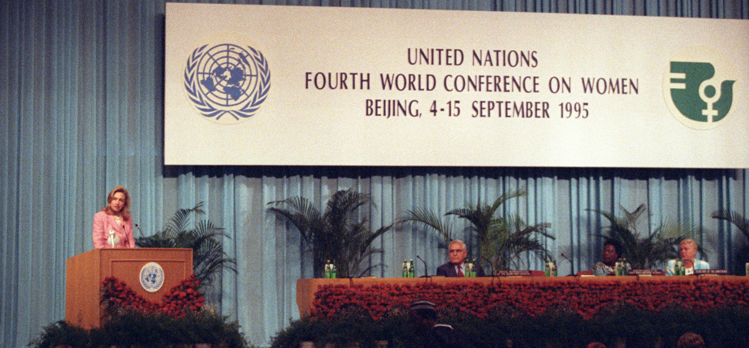
US First Lady Hillary Rodham Clinton
"Human rights are women's rights,
and women's rights are human rights"

Slide 12
Beijing Platform for Action
Most comprehensive agenda on women ever
12 Areas of Concern including new ones
    women and violence
    women and armed conflict
    women in power and decision-making
    women and the environment
    the girl-child
CSW role today: follow up on Beijing
  Annual CSW outcome document:
  the Agreed Conclusions

Slide 13
Bringing Beijing Home
San Francisco Beijing participants
  focus on CEDAW
  adoption of municipal ordinance 1998
  "promote equal access and equity ... for women and girls"
Los Angeles 2003
Cities for CEDAW inaugurated at UN CSW 2014
  localize human rights principles of CEDAW
  Goal: 100 US Cities for CEDAW

Slide 14
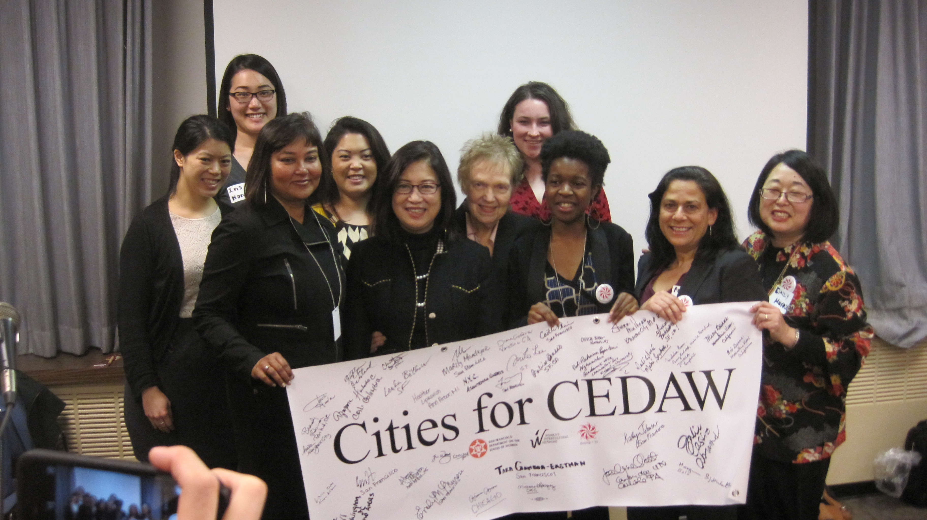
Cities for CEDAW at UN CSW 2014
with San Francisco CEDAW organizers

Slide 15
Cities for CEDAW
Three components for Cities for CEDAW:
  gender analysis of city government
  oversight body to monitor implementation of CEDAW
  funding in city budget of 10-25 cents per female resident
San Francisco case focused on three areas:
  women's employment
  violence against women
  health care access

Slide 16
San Francisco
City and community task force was oversight body
Hired gender consultant to facilitate city analysis
City departments became aware of disparities
  Public Works: different infrastructure needs, pay equity
  Rent Stabilization Dep't: needed disaggregated data
  Juvenile Probation: girls have history of trauma
  Police Dep't: revised police procedures for domestic violence
    led to dramatic drop in domestic homicides, none over 44 months
Many departments uncovered work-life balance concerns
  city initiated flextime and telecommuting options
  changes popular with both female and male employees

Slide 17
Other Cities
Los Angeles
  gender parity on all boards and commissions
  domestic and sexual abuse response teams in every city area
  IgniteLA: leadership training for young women
  LAFD Girls Camp: prepare girls to apply as firefighters
Kansas City
  no use of salary history in hiring process
  no eviction of survivors of domestic violence or sexual assault
  task force monitors women in decision-making positions
Cincinnati
  women's support group in Fire Department
  domestic violence trainings for city employees
Washington DC
  developing action plan for the city
  gender equity trainings planned for all city departments

Slide 18
Resources
CEDAW treaty: https://www.ohchr.org/sites/default/files/Documents/ProfessionalInterest/cedaw.pdf
Beijing Platform for Action: https://www.un.org/womenwatch/daw/beijing/platform/
Cities for CEDAW www.citiesforcedaw
Susan H. Lee, "Thinking Globally, Acting Locally," Societies Without Borders scholarlycommons.law.case.edu/swb/vol13/iss1/14/
Valerie Hudson, A Shadow CEDAW Report for the US
  https://bush.tamu.edu/wp-content/uploads/2023/04/A-Shadow-Cedaw-for-the-United-States-FOR-WEB.pdf
UN Global Compact Women's Empowerment Principles
unglobalcompact.org/take-action/action/womens-principles

