Slide 1
The Digital Divide: Native American Women and Girls
Carmela M. Roybal Ph.D., MBGPH, MA
US Women’s Caucus at the UN, CSW67
New York City, NY
March 14, 2023

Slide 2
Manhattan the Land of the Lenape
New York is the Land of the Erie, the Iroquois, the Mahican, Mohegan, Montauk, Neutral, Oneida and the Haudenosaunee, the Seneca Nation and home of many great Nations, all whose ancestors and decedents continue to thrive and fight for their lands, equality, and their voices as the first nations and the original peoples of the land in which the United Nations and CSW stand today.
We honor you; we give you thanks, we ask for your forgiveness, we ask your permission, and remember you in our thoughts and prayers. May you all be strong, stand strong, and live long into the future.
Kunda’Wo’ha’-Thank you

Slide 3
Indigenous Peoples, First Nations, and American Indians and Alaska Natives
Indigenous People represent 5% of the Worlds Population.
In Canada there are over 630 First Nation communities that representing over 50 Nations.
In the United States there are over 574 federally recognized tribal nations, not counting tribes that are fighting for federal recognition.
There are approximately 5.2 million American Indians and Alaska Natives making up approximately 2% of the U.S. population.

Slide 4
Forced Removal of Indigenous Peoples and Tribal Downsizing
1492- An estimated 112 million Native Americans lived on the land we refer to as the United States*.
Genocide* Policy* Disease*Forced Land Removal*Forced Removal of Children
1650- The Native American population declined to less than 5 million*.
2023-There are approximately 5.2 million American Indians and Alaska Natives making up approximately 2% of the U.S. population*.
*Deneven, William M. 1992, Thornton 1997 , U.S. Census 2020

Slide 5
The Indian Citizen Act- Voting Rights
1920-Native Americans in the U.S were granted citizenship.
1924-President gives Native people the right vote.
Voting was not universal- States blocked Native Americans from voting.
1948-Native Americans in New Mexico were denied the right to vote.
1962- Native Americans gain voting rights in all states.
1980-Native Americans allowed to run for county offices(South Dakota).
2013- Supreme Court takes away voting protections in Alaska, Arizona, and two counties in South Dakota.
2023-The Navajo Nation and Tribal Citizens are fighting redistricting that denies Indigenous votes an equal opportunity to participate in the political process.

Slide 6
Native American’s and The Armed Forces
Native American Women Serve in the Armed Forces at a greater rate than all other racial groups in the United States
Almost 20% of all Native American service members are women.
800 Women Served in WWII
Lori Ann Piestewa- Combat Veteran , Hopi Navajo

Slide 7
The State of Native American Women and Girls
Native American Women and Girls are Hyper Marginalized.
Nationally
5,712 Missing and Murdered Native American women have been reported (NCIC 2017).
Native American women in the state of New Mexico have the highest rate of homicide among all racial and ethnic groups (NMIBIS 2020).

Slide 8
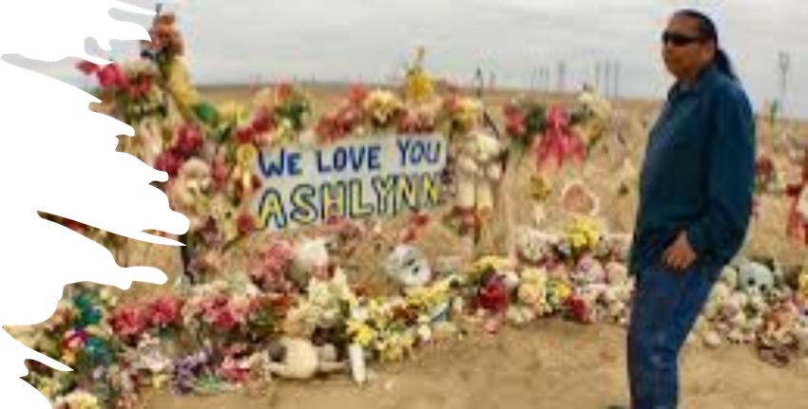
Native American Girls
Native Americans in New Mexico die at earlier ages and have the highest percentage of children who will not outlive their parents of any racial or ethnic group in the state.
Native American children have the highest childhood mortality rate when compared to all other racial and ethnic populations in the United States.
New Mexico
A Native American female child between the ages of 1-4 has a rate of premature death (55.6 per 100,000) significantly higher than their non-Hispanic White counterparts (-0.5 per 100,000) (CDC 2016).
The most recent figures show that Native American children in New Mexico had a death rate of 37.2 per 100,000, and non-Hispanic Whites with a rate of 19.4 per 100,000 (NM-Vital Records 2016).

Slide 9
Racialized Gender Wage Gap For Native American Women
Native American women experience higher rates of poverty than all other racial and ethnic groups.
In 2019, Native American women earned $0.60 for every dollar paid to white men (Connley, 2020).
Native American women with a fulltime job reported an average income of $36,577 (United States Census Bureau, 2020), compared to white women who earned $51,324 and white men who earned $65,208.

Slide 10
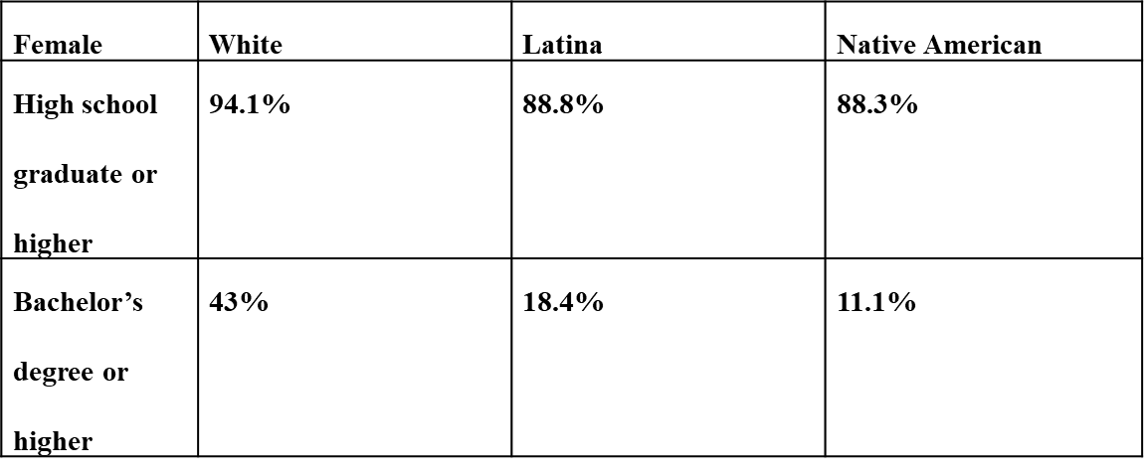
Intersection of Education and Technology and the Reproduction of Intergenerational Poverty
Opportunities for Higher Education.
Opportunities for STEM related Jobs and Education.
Quality Broadband for Education.
Technology Hubs on Reservations, Rural Communities.
Native AmericanThe ACS (2019) also reported that women with less than a high school diploma in Rio Arriba County had earnings that averaged $13,542 a year.
High school graduate or higher
94.1%
88.8%
88.3%
Bachelor’s degree or
higher
43%
18.4%
11.1%
*Rio Arriba County, NM Educational Attainment by Race and Degree

Slide 11
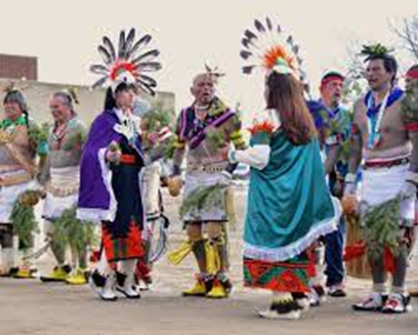
Native American Women: Science, technology, engineering, and Mathematics Degrees or Certificates (STEM)
Degrees of all levels as of 2021
1,093
Certificates Below an Associates Degree
203
Associates Degrees
242
Bachelor’s Degrees
540
Master’s
94
Doctor’s Degrees
14
Advanced Degrees –Doctoral Degrees in the US. 2021
NA ASIAN HISPANIC BLACK WHITE Non-US Resident
14 | 824 | 348 | 583 | 4098 | 3,965

Slide 12
Internet Access & the Impact on New Mexico Tribal Communities
Nationally, 68% of ALL tribal communities on reservations lack access to broadband services (FCC).
According to the FCC, 50% of Indian Health Service clinics rely on outdated service connections.
New Mexico
According to Census estimates approximately 26% of New Mexico’s population lacks broadband connections.
New Mexico ranks 48th in the nation for percentage of households with broadband internet subscriptions.
On estimate reports 80% of individuals residing on tribal land in New Mexico do not have internet services.

Slide 13
Examples- Unemployment & the 2020 Census
From February 2020 to April 2020, the state unemployment rate increased from 4.8% to 11.3%. Native Americans have the highest unemployment rate in New Mexico, making access to health benefits even more challenging
In a 2019 statewide survey, 71% of Native Americans reported having internet access at home or at work that would allow them to submit census information online----For tribes, a mere 1% UNDERCOUNT in the census could equal a loss of over $2 MILLION A YEAR in federal funding.
Resulting in nearly $21.5 MILLION LOST for Critical community programs and services across ten years for tribes in New Mexico.

Slide 14
Closing the Divide Saves Lives
HEALTH-The Digital Divide Put Lives at Risk
Cancer: Native American women were at higher risk of getting liver, stomach, kidney, colorectal, and cervical cancer.
During Covid-19- Native American Populations were disproportionately impacted.
2020-US Centre for Disease Control and Prevention (CDC) reported that Native Americans had 3.5 more COVID-19 cases than White Americans and hospitalization rates five times that of White Americans.
Technology, Quality Broadband Services…..
The Development of Digital Applications to ensure that preventative health services are available.
The Dissemination of Health-Related Materials
Patient Navigation Services
Digital Data Systems that allow Families to own and control their health data.

Slide 15
What Can Technology, Education, and the Eradication of the Digital Divide Accomplish.
Digital Literacy: Save Lives
Broadband Expansion in Rural Areas: Save Lives
The Education Gap: Build a Better Future for Native American Women, Girls, and Relative through the life course.
The Wealth Gap: Ending the technological divide has the potential to close the Wealth Gap and End the Reproduction of Intergenerational poverty.

Slide 16
Policy Recommendations
Collaborate and Partner-Native American Budget and Policy Institute
Exercise Education Sovereignty
Build International Alliances—Cross Borders, Cross Boundaries, Cross Digital Space
Invest in Native American Organizations, Entrepreneurship
Donate to Native American Serving Organizations
Organizations Promoting the advancement and inclusion of Native Americans in advanced degrees, careers, and Positions of Leadership
American Indian Science and Engineering Society (AISES)
Society for the Advancement of Chicanos/Hispanics and Native Americans (SACNAS)
The American Indian College Fund
National Action Council for Minorities in Engineering.

Slide 17
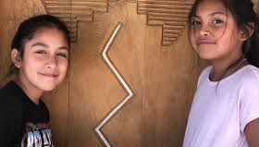
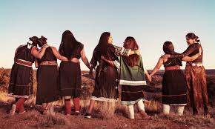
KUNDA’WO HA, HERKERM, THANK YOU
“A nation is not conquered until the hearts of its women are on the ground. Then it is finished, no matter how brave its warriors or how strong their weapons.” – Cheyenne proverb
Carmela M. Roybal, PhD MBGPH MA
Executive Director, Native American Budget Policy Institute, University of New Mexico
www.carmelaroybal.com
croybal@avanyuhealth.com
cmoral7@unm.edu

Slide 18
Violence Against Women, Girls, and Relatives
Nationally
5,712 Missing and Murdered Native American women have been reported (NCIC 2017).
New Mexico
Native American women in the state of New Mexico have the highest rate of homicide among all racial and ethnic groups (NMIBIS 2020).
NM Urban Centers
New Mexico’s urban centers have some the highest missing person’s cases in the country. Between Albuquerque, Gallup, and Farmington there were 715 missing Indigenous person’s cases were reported between 2014-2019.

