Slide 1
Religious Perspectives
on Abortion
Women's Intercultural Network
Women's Equality Day
August 27, 2022
The Rev. Susan H. Lee, Ph.D.
President
US Women's Caucus at the UN

Slide 2
The Episcopal Church
General Convention 1976-D095
Christians have a responsibility to limit the size of their families
and to practice responsible birth control.
Termination of pregnancy is permissible in cases of rape or incest;
where the mother's physical or mental health is seriously threatened;
where child would be born seriously deformed in mind or body.
If abortion is considered for other reasons,
one should first seek other preferable courses of action such as adoption
The Episcopal Church is unequivocally opposed to any state or national legislation
that would abridge or deny the right of individuals to reach informed decisions
in this matter and to act upon them.

Slide 3
United Methodist Church
United Methodist Church Book of Discipline 2016, "Social Principles"
Our belief in the sanctity of unborn human life makes us reluctant to approve abortion.
But we are equally bound to respect the sacredness of the life and well-being
of the mother and the unborn child.
We recognize tragic conflicts of life with life that may justify abortion,
and in such cases we support the legal option of abortion
under proper medical procedures by certified medical providers.
We entrust God to provide guidance, wisdom, and discernment
to those facing an unintended pregnancy.
The Church shall encourage ministries to reduce unintended pregnancies
such as comprehensive, age-appropriate sexuality education
advocacy in regard to contraception
and support of initiatives that enhance the quality of life for all women and girls.

Slide 4
Southern Baptist Convention
Baptist Faith and Message 2020
Children, from the moment of conception, are a blessing and heritage from the Lord.
Southern Baptist Convention Annual Meeting June 2021, "On Abolishing Abortion."
All humans are created in God’s image by, through, and for Jesus to the glory of God,
and all souls belong to Him (Genesis 1:27).
To murder any preborn image-bearer is a sin violating ... the sixth commandment
forbidding murder, and as such, is ultimately an assault on God’s image,
seeking to usurp God’s sovereignty as Creator (Genesis 9:6, Exodus 20:13).
Abortion is murder, and we reject any position that allows for any exceptions
to the legal protection of our preborn neighbors.
We affirm that the murder of preborn children is a crime against humanity.
We call upon governing authorities at all levels to repent and ... exhorting them
to bear fruit in keeping with repentance by faithfully executing their responsibilities
as God’s servants of justice ... abolishing abortion immediately, without exception
or compromise (Romans 13:4).

Slide 5
Examples of Biblical passages in SBC resolutions
Genesis 1:27 So God created mankind in his own image, in the image of God he created them, male and female he created them.
Genesis 9:6 Whoever sheds human blood, by humans shall their blood be shed; for in the image of God has God created mankind.
Exodus 20:13 You shall not murder.
Romans 13:4 For the one in authority is God's servant for your good. But if you do wrong, be afraid, for rulers do not bear the sword for no reason. They are God's servant, agents of wrath to bring punishment on the wrong-doer.
Translation: New International Version

Slide 6
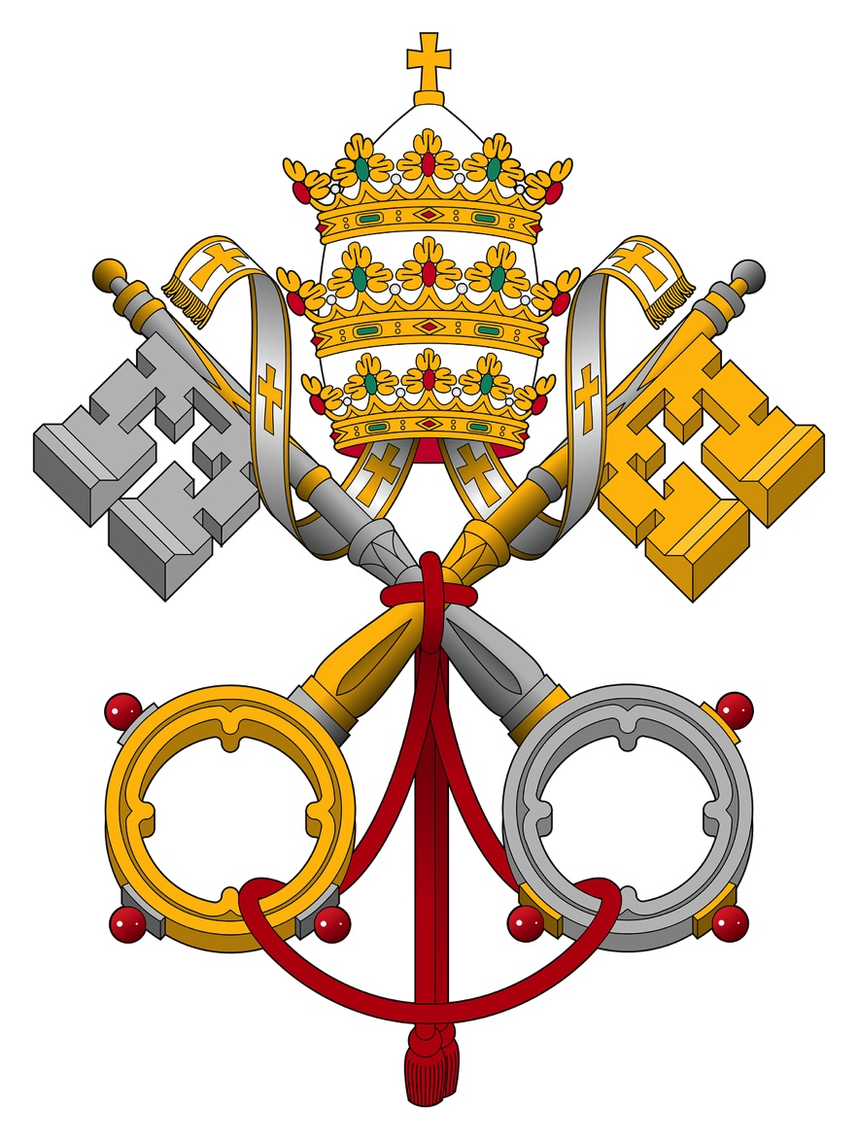
Roman Catholic Church
Early Catholic ideas of "ensoulment" based on Greek thinking from Aristotle:
In the first few weeks of pregnancy, the fetus is "unformed"
then receives a rational soul at quickening.
Catholic penalties for abortion before ensoulment were less severe, though still a sin.
Abortion after ensoulment was viewed as murder.
Those views changed in 19th century with scientific understanding of conception.
From the Catechism of the Catholic Church 2016:
Human life must be respected and protected absolutely from the moment of
conception. From the first moment of his existence, a human being must be
recognized as having the rights of a person - among which is the inviolable right
of every innocent being to life (paragraph 2270).
From Ethical and Religious Directives for Catholic Health Care Services, Sixth Edition
Every procedure whose sole immediate effect is the termination of pregnancy
before viability is an abortion, which, in its moral context, includes the interval
between conception and implantation of the embryo (paragraph 45).
Operations, treatments, and medications that have as their direct purpose the cure of a
proportionately serious pathological condition of a pregnant woman are permitted when
they cannot be safely postponed until the unborn child is viable, even if they will result
in the death of the unborn child (paragraph 47).

Slide 7
Roman Catholic Views on Contraception
From Humanae Vitae Encyclical by Pope Paul VI, July 25, 1968
God designed sex to bring married couples together in unity, and to procreate.
Those two functions must remain united in order to be faithful to God's designs.
Therefore contraception, abortion and sterilization (of either man or woman)
is against God's purposes.
The only acceptable form of family planning for Catholics is to use the natural cycles
of reproduction to avoid conception.
From Ethical and Religious Directives for Catholic Health Care Services, Sixth Edition
A female who has been raped should be able to defend herself against a potential
conception from the sexual assault. If, after appropriate testing, there is no evidence
that conception has occurred already, she may be treated with medications that
would prevent ovulation, sperm capacitation, or fertilization. It is not permissible,
however, to initiate or to recommend treatments that have as their purpose or direct
effect the removal, destruction, or interference with the implantation of a fertilized ovum.

Slide 8
Jewish and Muslim Perspectives
From the Conservative Rabbinical Assembly statement in response to Roe decision:
The Committee on Jewish Law and Standards of the Rabbinical Assembly has repeatedly
affirmed the right of a pregnant person to choose an abortion in cases where ‘continuation
of a pregnancy might cause severe physical or psychological harm, or where the fetus is
judged by competent medical opinion as severely defective.’
This position ... does not indicate that personhood and human rights begin with conception,
but rather with birth as indicated by Exodus 21:22-23.
Exodus 21:22: If people are fighting with each other and happen to hurt a pregnant woman
so badly that her unborn child dies, then, even if no other harm follows, he must be fined.
International Islamic Fiqh Council, Mecca, Saudi Arabia
If proven by a committee of at least two competent and trustworthy medical experts on the
basis of medical examinations ... before 120 days of pregnancy that the fetus has serious
anomalies that will be present at birth, only then is it permissible to abort.
When the pregnancy reaches or is beyond the 120th day, abortion becomes totally forbidden
and is deemed a form of murder that will result in prosecution unless the continuation of the
pregnancy to full term poses a risk to the mother’s life.

Slide 9
Incidence of Contraception Use and Abortion
From the Guttmacher Institute:
99% of US people who identify as religious have used artificial contraception
including both Catholics and Protestants.
Only 1% have solely used natural family planning methods
Most people who get an abortion have a religious affiliation (2014 figures):
17% mainline Protestant
13% evangelical Protestant
24% Catholic
8% some other religious affiliation
38% no religious affiliation

