Slide 1
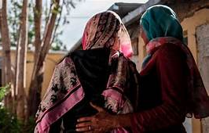
SGBV as a Weapon of War and Tool For Genocide
The systematic and brutal nature of the sexual violence in Tigray, especially the sexual torture and mutilation points to the weaponization of sexual violence and its use as a genocidal tactic.
Sexual assaults and violence have occurred across the Tigray region with rape camps created in several locations by federal allied troops.
Ethnic Cleansing
Sexual Slavery
Intentional Transmission of HIV
Irreversible damage to Reproductive Systems

Slide 2
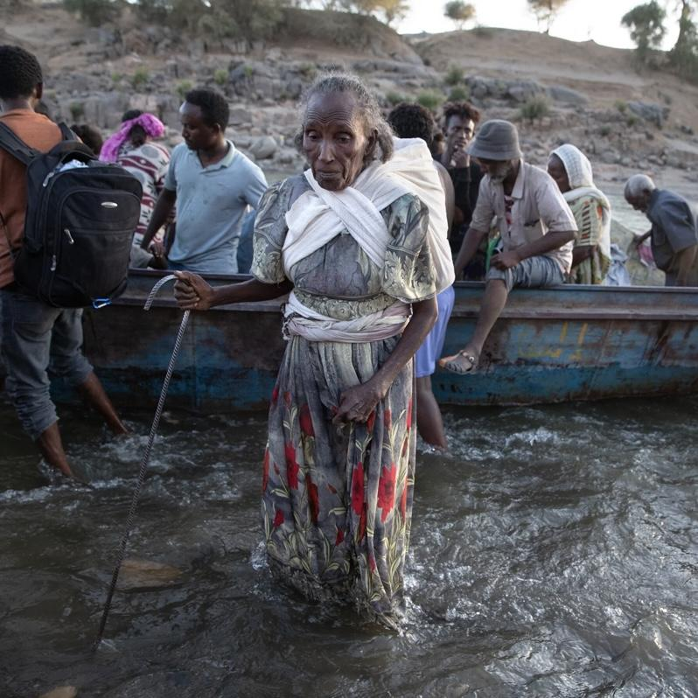
Ethnic Cleansing in Western Tigray
Soon after the federal government declared war on Tigray, various armed groups from the neighbouring Amhara region joined the offensive against Tigray to annex land in Western and Southern Tigray that they claim historically belongs to them.
Over 70,000 Tigrayan refugees fled to neighbouring Sudan came primarily from Western Tigray. Refugees detailed how Amhara forces systematically rounded up Tigrayans in house-to-house searches. Those that managed to escape described massacres, kidnappings and arbitrary detention by armed forces from the Amhara region.

Slide 3
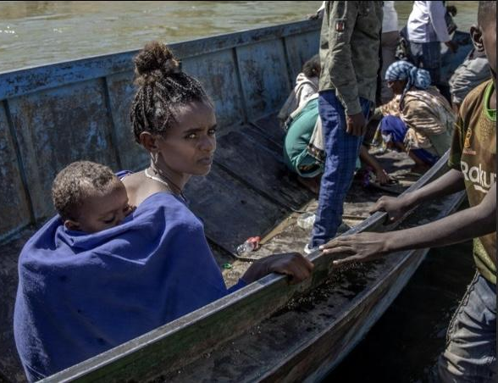
Survivors who managed to escaped to Sudan recalled militia telling them “You Tigrayans have no history, you have no culture. I can do what I want to you and no one cares.”
Amhara milita operate with total impunity in Western Tigray and openly tell survivors their goal is to cleanse the Tigrayan bloodline. Another survivor was told “If you were a man we would kill you but girls can make Amhara babies”
Refugee accounts also show that Tigrayans are having their IDs destroyed and being issued Amhara ID cards, are being barred from speaking their native language and that women are facing SGBV with the explicit intent of ‘Amharanizing’ them.
The full-fledged campaign of ethnic cleansing in Western Tigray continues until this day.

Slide 4
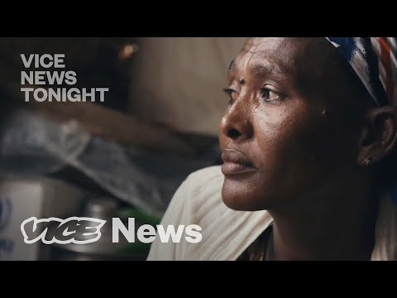
https://www.youtube.com/watch?v=oOIhNSJSE_U&t=224s

Slide 5
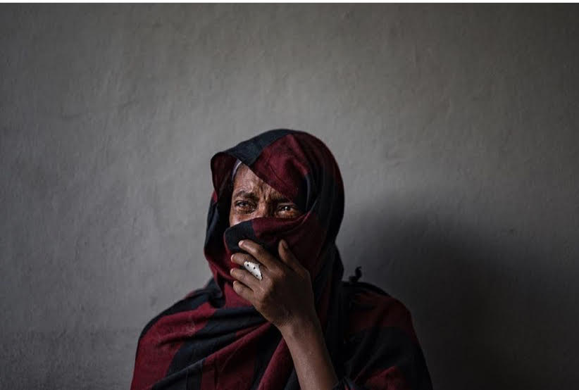
Sexual Slavery
“It was like they were fetching water” - A rape survivor describing how soldiers would line up outside her cell waiting for their turn to rape her.
Survivors reported being held for days or weeks as they were repeatedly raped by several soldiers. They were taken off streets, buses and directly from their homes by soldiers.
Notes:
Women and girls were pulled off buses, taken from the streets or their homes by these soldiers. There was no place where they couldn’t gain access to them so women and girls were not safe anywhere. Sexual slavery was taking place in Tigray since the very first days of this war. A 21 year old waitress from a town at the ethiopian-eritrean border told Amnesty International that she was abducted by Eritrean and Ethiopian soldiers on November 5th, 2020 and held for 40 days with 30 other women. She said all of the women were raped, and the soldiers took turns with 5 or 6 of them raping them at a time..

Slide 6
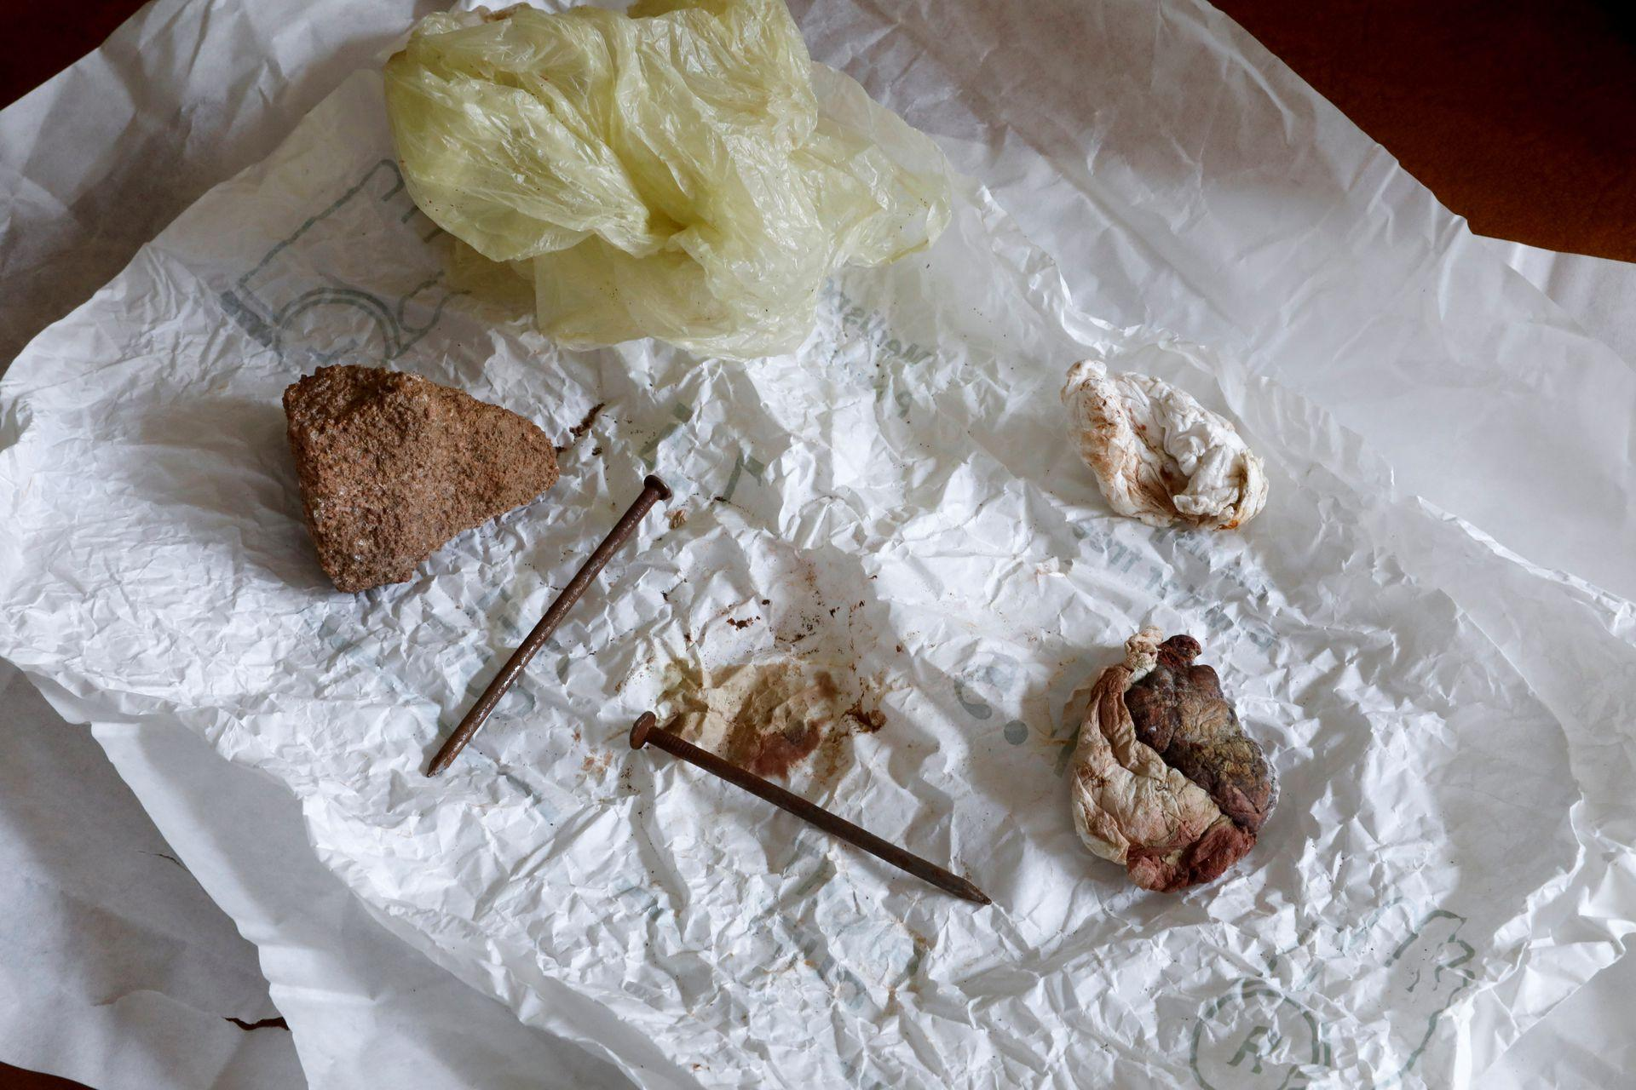
Women in Tigray have reported that soldiers told them they are HIV positive and intentionally wanted to infect them. One survivor warned the soldiers that she was HIV positive. She showed them her medicine as proof but they gang raped her without any protection. She believes they must have been HIV positive. They said they wanted to spread HIV among the women and girls in Tigray.
Another survivor was able to go to the hospital after her attack to get some post-exposure HIV drugs. The soldiers who attacked her learned about this as they often frequent the hospitals and returned to her home. They said “We want you to be sick. We’re here to make you HIV positive.”
Items that doctors retrieved from the vagina of a rape survivor are seen at a hospital in the town of Adigrat, Tigray. March 18, 2021
Notes:
The physical trauma that women and girls face amounts to sexual torture as women were penetrated with hot metal, sticks, nails, and other objects. In some cases, the severity of the injuries have led to sterilization or surgical removal of the uterus.

Slide 7
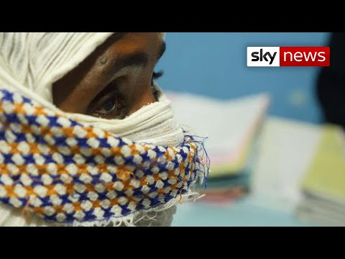
https://www.youtube.com/watch?time_continue=263&v=ECo0sByGmiQ&feature=emb_title

Slide 8
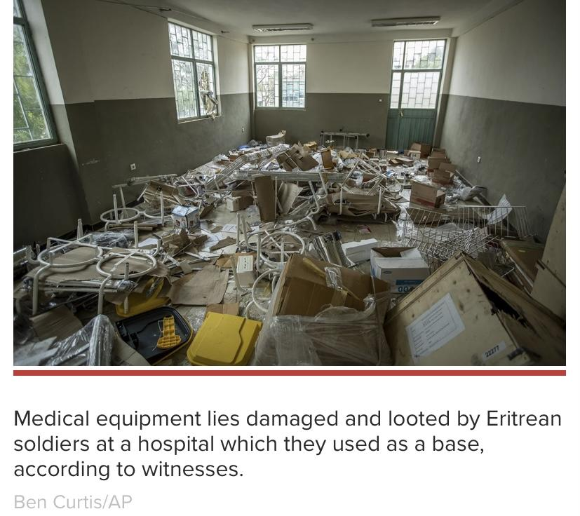
Destruction of Healthcare System
Initial assessments by MSF of 106 facilities in Tigray between December 2020 and March 2021 show that nearly 70 percent of facilities were looted, 30 percent damaged, and only 13 percent in Tigray were functional.
“I’ve been doing this work for a long time and I’ve never seen the complete collapse of a healthcare system as in Tigray. It’s shocking.”— Médecins SansFrontières emergency manager on the ground, April 2021

Slide 9
In April, UNFPA reported that only 1% of health facilities in Tigray had the capacity to provide comprehensive gender based violence services. UNFPA also projects that approximately 22,500 survivors of sexual violence in Tigray will seek clinical care this year alone. This shows the dire gap between the growing needs of survivors and the lack of support available for them.
Hospitals were also occupied by federal allied troops. Hospital staff told Human Rights Watch that soldiers would come into the facilities searching for specific rape survivors or health records. When a rape survivor was admitted into a hospital, Eritrean troops heard about this and came into the hospital a few times looking for her.

Slide 10
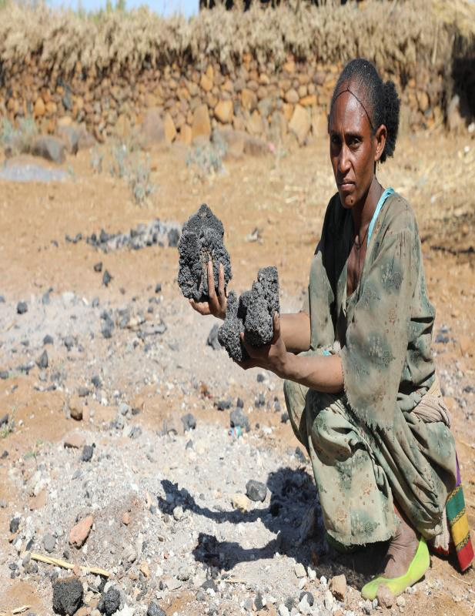
Manufacturing a Famine
Destruction of farms and cropland: large-scale damage to vital farming infrastructure, where the troops have burned farmhouses, intentionally ruined seeds, and destroyed grinding mills.
Prohibition of farming: Federal allied troops prevented farmers from ploughing their land in time for rainy season and many farmers missed an entire cycle of production.
In May 2021, a member of Tigray’s former interim government, appointed by Abiy Ahmed, admitted this campaign was taking place. He stated, “There is a campaign that has been started to prevent farming. Regrettably, this campaign is being done by some of those tasked with law enforcement."
Abrehet Wubet in Samre, Tigray showing her burned grains. Here grinding mill and her grains were burned by invading troops..

Slide 11
Notes:
More than 18,800 pregnant and nursing women screened in the first week of November, of whom more than 11,600 or 69 per cent were diagnosed with malnutrition.

Slide 12
Humanitarian Blockade
Martin Griffith, Current U.N. Undersecretary General for Humanitarian Affairs (Nov 12, 2021)
“The women are still, after these many, many months, so traumatized that it's difficult for them to speak.
We said to the women, what do you want for your children? The answer that they gave us was, we want food. They have no horizon beyond survival, beyond tomorrow...And I think that was perhaps the most shocking example of the depth of need in Tigray.”
“Tigray is probably the worst place in the world to live in right now.”
Mark Lowcock, Former U.N. Undersecretary General for Humanitarian Affairs (Oct 6, 2021)
“What's happening is that Ethiopian authorities are running a sophisticated campaign to stop aid getting in by, for example, making it impossible for truck drivers to operate by setting up checkpoints with official and with militia people, by preventing fuel getting in.
And what they are trying to do is starve the population of Tigray into subjugation or out of existence..”

Slide 13
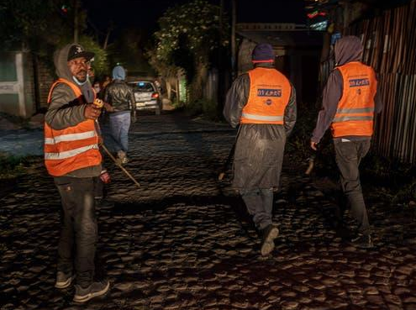
Mass Arrests of Tigrayans Across Ethiopia
On November 2, 2021, The Ethiopian government issued a nation-wide State of Emergency because Tigrayan forces inched closer to Ethiopia’s capital. Federal authorities began mass arresting Tigrayan civilians rom their homes, work and places of worship.
In an interview with Vatican News, Fr. Giuseppe Cavallini, a Comboni missionary who has served in Ethiopia for 30 years, explained that even churches have not been spared amid the government crackdown.
“A few days ago," he said, “the military entered the Catholic Cathedral of Addis Ababa looking for people of Tigrinya ethnicity. And these raids are being done throughout the capital."
A vigilante group searching for Tigrayans who they believe are sympathetic to the Tigrayan government

Slide 14
Ethiopian Human Rights Commission (EHRC)
State-funded and Head Commissioner, Daniel Bekele, is state-appointed
Played a biased and inflammatory role since the first days of the war ex. Mai Kadra massacre reporting where Tigrayan victims were painted as perpetrators.
Public statements made by Daniel Bekele support government’s narrative
- “It’s comforting to know the military operation didn’t result in as severe consequences as it was originally feared to be. There was talk of a huge bloodbath, talk of huge civilian casualties…” (Jan, 2021)

Slide 15
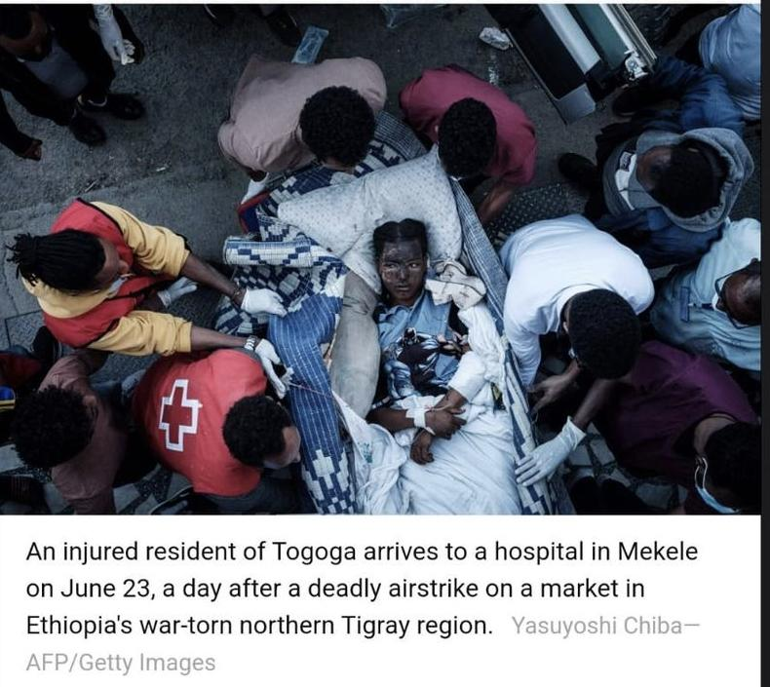
EHRC and UN Human Rights Joint Investigation
Little to no mention of crimes perpetrated by Amhara militia and special forces
Victims lacked trust in state-appointed investigators and declined to speak to them
Deliberate exclusion of credibly reported atrocities ex. Axum massacre, Togoga massacre, Humera massacre

Slide 16
Commission of Inquiry
We are calling on the UN Human Rights Council to hold a special session and pursue establishing a Commission of Inquiry.
The influence and participation via the EHRC of the Government of Ethiopia – a belligerent in the conflict and the principal party accused of war crimes, crimes against humanity and acts of genocide – is a violation of not only principles of impartiality and neutrality, but contravenes longstanding UN norms.
A Commission of Inquiry would be a crucial first step in ensuring full accountability for all atrocities. It will uphold the principle of “do no harm.” Victims can also regain confidence in these investigations.

Slide 17
Recommendations for U.S Senate
On September 23, the House of Representative passed the National Defense Authorization Act (NDAA) for FY2022, H.R 4350 Amendment 555 which requires the Secretary of State to submit a determination of whether atrocities committed in the Tigray region constitute genocide or crimes against humanity.
The NDAA is coming before the senate in the coming weeks, we are urging senators to introduce a similar amendment to ensure that Amendment 555 is kept in the final adoption of NDAA FY2022.
Notes:
In March 2021, Secretary Blinken publicly stated that ethnic cleansing was occuring in Western Tigray

Slide 18
Resources to Help End the Tigray Genocide
Omna Tigray: U.S based advocacy group
https://omnatigray.org/
Health Professional Network For Tigray: Tigrayan-led organization working on the ground in Sudan refugee camps
https://hpn4tigray.org/
Tigray Youth Network: UK based advocacy group
https://tigrayyouthnetwork.org/

